Slide 1

Indifference Curve

Slide 2

an indifference curve is a graph showing different bundles of goods between which a consumer is indifferent.

Slide 3

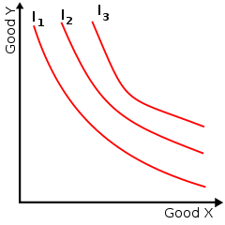
Transitive Having the property that if an element x is related to y and y is related to z, then x is necessarily related to z.
utility The ability of a commodity to satisfy needs or wants; the satisfaction experienced by the consumer of that commodity.

Slide 4

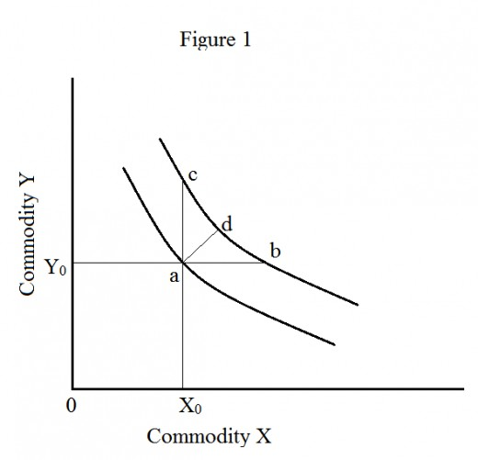
Indifference curve to the right represent higher level of satisfaction

Slide 5

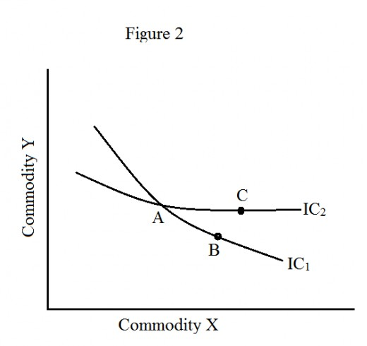
Indifference curves do not intersect

Slide 6

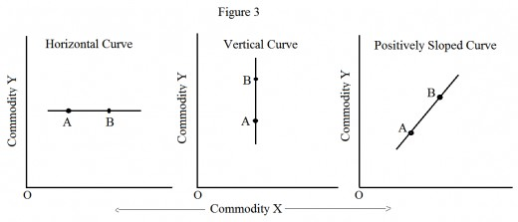
Indifference curve has a negative slope

Slide 7

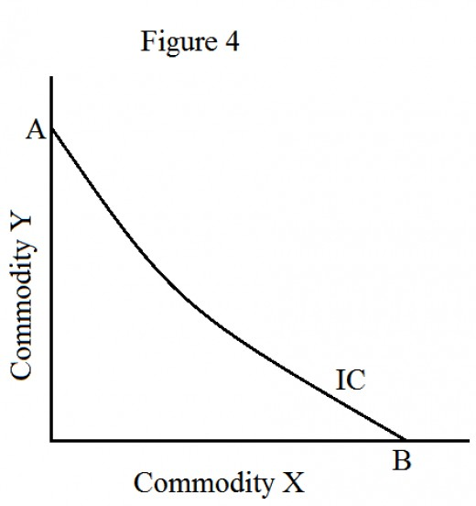
Indifference curves do not touch either axes

Slide 8

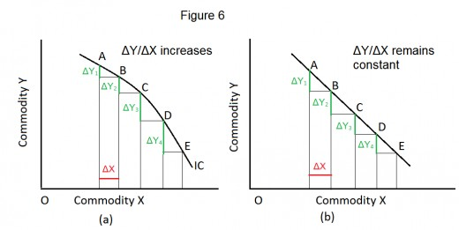
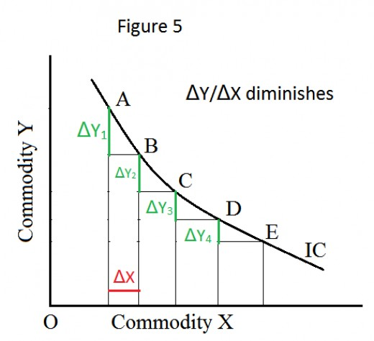
Indifference curves are convex to the origin
As evident in Figure 6(a) , IC is concave to the origin. In such a situation , ΔY₂ >ΔY₁, ΔY₃ > ΔY₂, and so on. Hence, consumer get increasing MRS of X for Y.
From Figure 6(b) it is evident that a straight line as an IC . Means
ΔY₁ = ΔY₂, ΔY₂ = ΔY₃, and so on. Hence, the MRS of X for Y remains constant. Both the examples is against the normal behavior of MRS that is diminishing in IC.

Slide 9
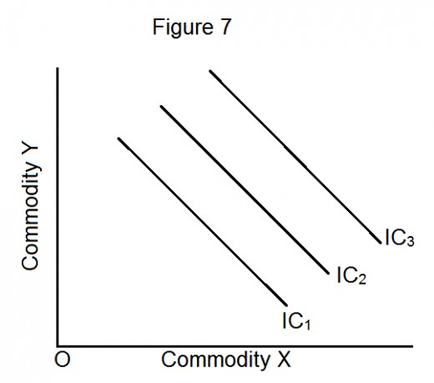
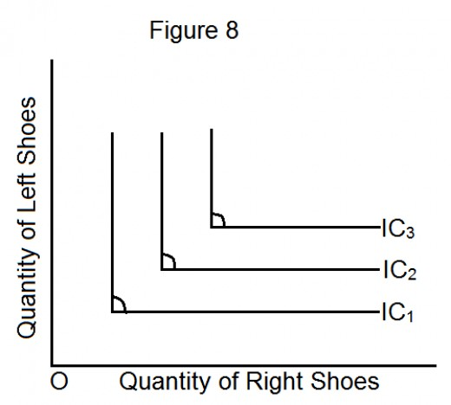
Complementary goods mean that one cannot consume one commodity without another (for instance, car and fuel). The IC for complementary goods is L-shaped.
In case of two commodities which is substitutes (interchangeable), their IC will be a straight line. the MRS remains constant.

Slide 10
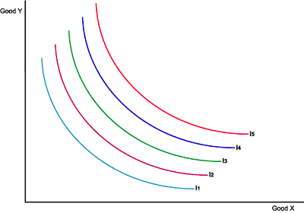
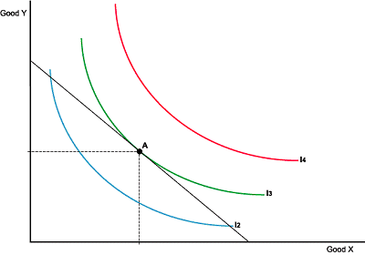
A rational consumer would prefer to be on the highest possible IC given their budget constraint. This point occurs where the indifference curve touches (is tangential to) the budget line. The optimum consumption point occurs at point A on indifference curve IC3 in this example .

Slide 11

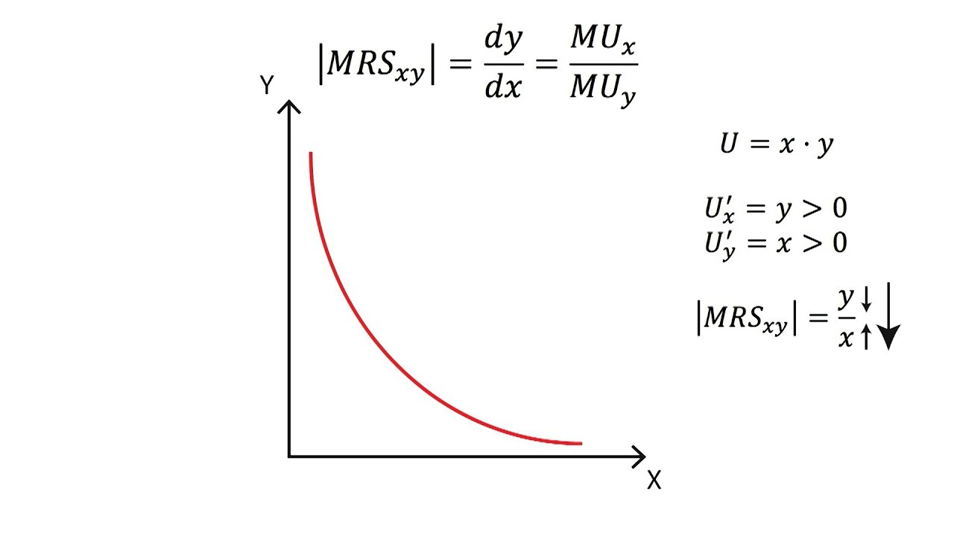
The rate at which a consumer can give away some amount of one good in conversation for another good while maintaining the similar level of utility is considered MRS in Economics.

Slide 12

In this figure presume points A & B are on the same indifference curve & consequently have the same utility level.
Let’s disintegrate the move from point A to B into 2 parts.
A→D: ΔTU = ΔC (MU_{C})
D→B: ΔTU = ΔF (MU_{F})
A→B:
0 = ΔTU = ΔC (MU_{C}) + ΔF (MU_{F})
⇒ ΔC (MU_{C}) = – ΔF (MU_{F})
⇒ ΔC/ΔF = – MU_{F} / MU_{C}
Clothing C
A
B
D
Food F
So beside an indifference curve, the slope or MRS is the negative of the ratio of the marginal utilities (with the MU of the good on the horizontal axis in the numerator).
MRS = – MU_{X} / MU_{Y}

Slide 13

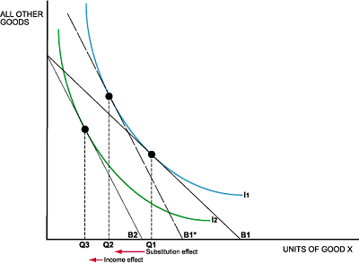
This Figure show an increase in the price of good x (a normal good)Due to the price of good x increasing, the budget line has pivoted from B1 to B2 and the consumption point has moved.
The decrease in the quantity demanded can be divided into two effects;
1.The substitution effect
2. The income effect

Slide 14

The substitution effect is when the consumer switches consumption patterns due to the price change alone but remains on the same indifference curve.
To identify the substitution effect a new budget line needs to be constructed.
The budget line B1* is added, this budget line needs to be parallel with the budget line B2 and tangential to IC1.
Therefore, the movement from Q1 to Q2 is purely due to the substitution effect.

Slide 15

The income effect highlights how consumption will change due to the consumer having a change in purchasing power as a result of the price change.
The higher price means the budget line is B2, hence the optimum consumption point is Q2.
This point is on a lower indifference curve (IC2).

